Slide 1

The Brand
Demand Forecasting for New Products

Slide 2
Agenda
Context
Objective
Given data
Problem formulation
Model limitations
Model evaluation
North star solution
Building the model
Data cleansing
Feature selection
Desired feature engineering
Categorical encoding
Modeling
Git repository

Slide 3
Context

Slide 4
Objective
Forecast unit sales demand for potential new products for the quarter following the launch
Assumption: The prediction is to be made for first quarter after launch
Notes:
The Brand is a niche online boutique that develops designer products in partnership with other businesses and plans limited quantity flash sales for them.
Use case: An accurate demand prediction for a potential new product's sales event can help produce the right quantity of these products.
The time period of unit sales of input data is not given and it is not clear that what time period is the prediction required for. Generally, very long-term forecasts are not accurate so let us assume that the given data is for first quarter of launch and we have to also predict the unit sales for first quarter of launch.

Slide 5
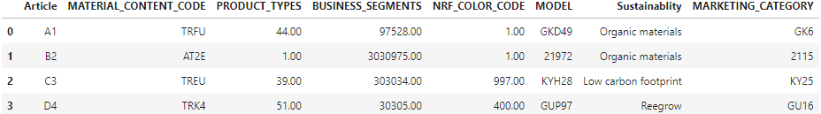
Given data
Product attributes
Historical product unit sales
Historical product searches and social references
Assumption: The last 2 datasets have data for first quarter of launch
Notes:
All product attributes are categorical.
This has some outliers
Did not do much with these. However, a model can be made to predict these too
60670 rows in merged DataFrame.

Slide 6
Problem formulation

Slide 7
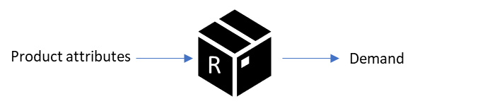
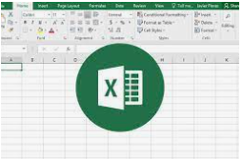
Problem formulation
One way to solve this is Regression
Product attributes and other features as predictors
Unit sales as target
Is regression model better than the existing business process for demand estimation?
Define the baseline to compare the regression model to -
Manual report by analyst to check similar articles and take an average of sales from mirror time frame

Slide 8
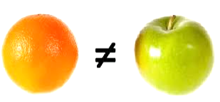

Problem formulation
Cold start problem
Regression fails if the model has no historic data points to learn from
Use market research about potential market for a completely new product
Or use sales information of similar products from competitors
Building confidence with stakeholders
Good to show top N most similar articles alongside model prediction

Slide 9


Regression model limitations
Fails for completely new article
Cannot be used as-is if macro factors change in test period
Needs to be adjusted for black swan events like COVID-19
Not reliable if there are any website display changes or changes in marketing strategy in the launch period
Not reliable if there are other product launches or ongoing events in parallel on the website
Does not take into account the cannibalization effects (both on the new products, and by the new products)
Does not take into account rising and falling trends on its own
Notes:
Cannibalization is a very subtle interaction of relative pricing, inventory levels, etc.
We could have a separate trends prediction model and overlay its predictions on top of the predictions of this one

Slide 10
Model evaluation
Model will be evaluated on a hold-out test dataset (20% of original data given) using MAE (or MAPE)
Assuming that the `MODEL` feature in the data corresponds to an actual model i.e. a bunch of articles with color variations, then a model would be a whole new product. As a result, the train and test split should not lead to articles of the same model getting into both training and test dataframes
This model should also be compared to a baseline process/model to see if this regression does better or not
Notes:
Additionally, we might need to further split training set to create a validation set if it is being used by the algorithm. This is esp. useful when we want to use `early_stopping`.
K-fold cross-validation is another option which makes sense to be used in this problem.
However, we are not using that flow for now.

Slide 11
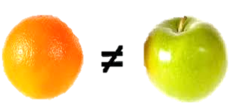
North star solution - NPD suite

Slide 12
Building the model

Slide 13
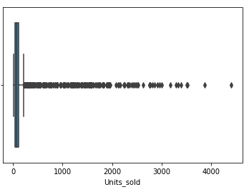
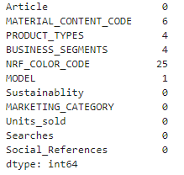
Data Cleansing
1- Missing values discarded
2- Outliers removed from TARGET
3 - Drop ID features
Article
Model
Notes:
Checked for duplicates
Checked for dtypes
Only 0.57% outliers at threshold of 216

Slide 14
Feature selection
High cardinality features
EDA shows features affect the target
Feature selection with this limited set of features is not required
Should check feature correlations and/or use feature importance charts to drop redundant features when we have more features

Slide 15
Desired feature engineering
Apart from the features already given, there are many more desirable features that would improve the predictive power of this model. Some of these are:
1. Which quarter was this product launched in?
2. Did the quarter have a major holiday like Xmas or an external or internal event like Black Friday, competitor activities, etc. that might affect sales?
3. Season
4. (This year - Year) when this historic product was launched
- This column could be used as a proxy for data recency and hence, relevancy. So this could be used to weight the training data points if the data points are too many or if this is seen to improve predictions in general.
5. More product attributes
6. Search trends (from Google Trends). Example- Sustainability is important to consumers now, neon colors are in vogue in shoes, face mask and sunglasses chords are trending, etc.
- How hyped up is this trend/designer? This data can also be sourced from customer focus groups.

Slide 16
Desired feature engineering
7. Price band of the article
8. Features around affluence level of the expected consumer demographic
9. How saturated is this product space already on the website and in terms of competition in general
- Count of similar products on website and their popularity
- Count of products (choice) within same category on website
- Market size of this category
- Market growth rate of this category QoQ, YoY
10. Is this a new category or color combination, etc.
- Innovation points
- Similarity distance from existing range in category
11. Historic sales data of similar existing products offered by competitors
- From consumer panel data, identified by text embeddings
12. Product usage – Gifting or not, Gender, etc.

Slide 17
Categorical encoding
Mapped NRF color codes to color groups to reduce cardinality
Used Ordinal encoder for low cardinality features – sustainability & NRF color group
Used M-estimate encoder for remaining high cardinality features
The value of `m` can be tuned in this encoder to get better model accuracy. Also, various other encoders could be tried from http://contrib.scikit-learn.org/category_encoders/index.html
This encoder runs the risk of data leakage so tuning it is very crucial
The holy grail solution to categorical encoding would be attribute clustering or embeddings
Notes:
Ordinal encoder is not the best but can be a good starting point.

Slide 18
Modeling
Model requirements:
- Should be able to detect interactions without coding for interaction features
- Should be able to handle new values of categorical features
- Should be able to handle feature selection
- Should generalize well and be less prone to overfitting
Decision trees are generally better at uncovering feature interactions without explicitly coding for them. Therefore, in interest of time, we will skip testing linear regression models but ideally, this should be done.
Notes:
For the first requirement, we did not even try linear regression.

Slide 19


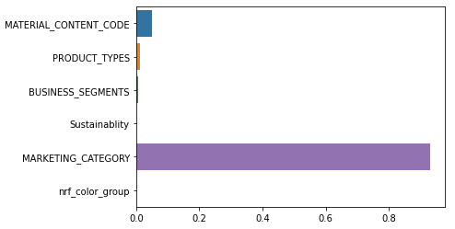
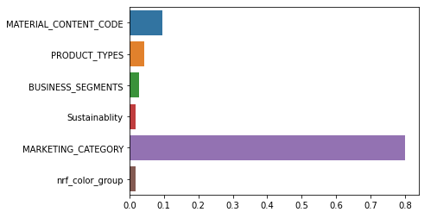
Random Forest vs Gradient Boosting Regressor
Random Forest
Gradient boosting regressor
New data point prediction:
71.97
Article | MATERIAL_CONTENT_CODE | PRODUCT_TYPES | BUSINESS_SEGMENTS | NRF_COLOR_CODE | MODEL | Sustainablity | MARKETING_CATEGORY
GA756 | AT2F | 1 | 30308 | 734 | P2413 | Low carbon footprint | P219
Notes:
There are more tree ensemble to try out. Catboost is esp. good when too many categorical features are involved. Lightgbm is another frequent winner.
Comparable first results from both models without any tuning.
GB slightly better and also much faster.
Both models are overfitting and this can be tuned.
The high feature importance of `MARKETING_CATEGORY` indicates towards the inadequacy of m-estimate encoder here. So this should be improved.

Slide 20
Model Tuning
Try other regression algorithms too
Catboost is especially recommended when majority features are categorical
Try out transformation functions on the target feature
Try various other model loss function and evaluation metrics
Use validation data to optimize the model training
Feature importance chart indicates the need for better categorical encoding methods
Tune model parameters using gridsearchCV, randomisedsearchCV or hyperopt, etc.
Add more predictors coupled with feature selection

Slide 21
Good-to-have next steps
Create a SHAPLEY tree interpreter
What features drive a prediction
Understand isolated effects of a feature on the target
Understand what features are missing
Understand various feature interactions
Add prediction intervals

